Slide 1
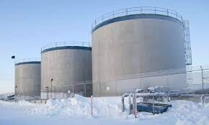
ADAC Year 8 Annual Meeting
ADAC Project Briefing
Arctic Facilities and Infrastructure Environmental Change Risk Index (ERI)
Dr. Craig Tweedie, University of Texas El Paso
Dr. Matt Calhoun, University of Alaska Anchorage

Slide 2
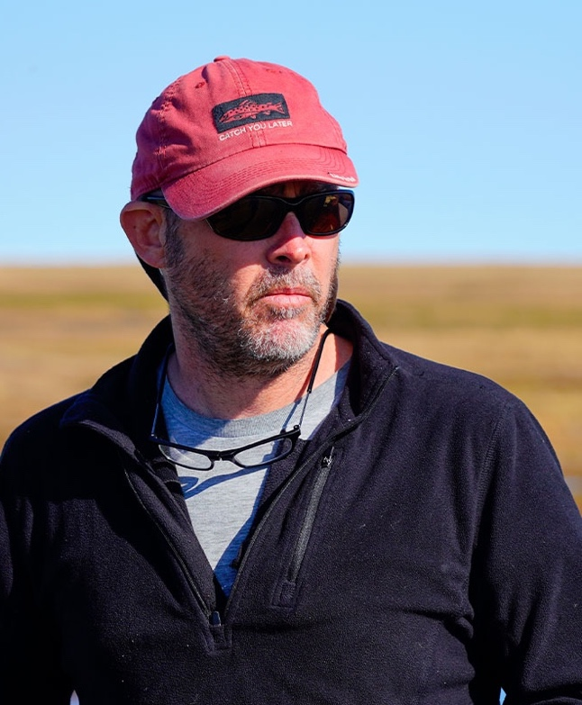
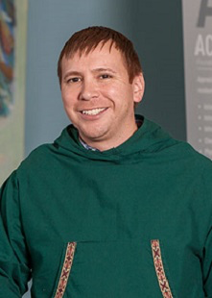
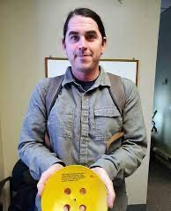
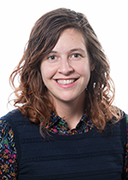
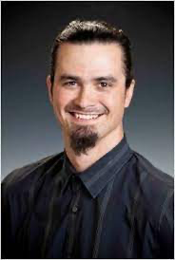
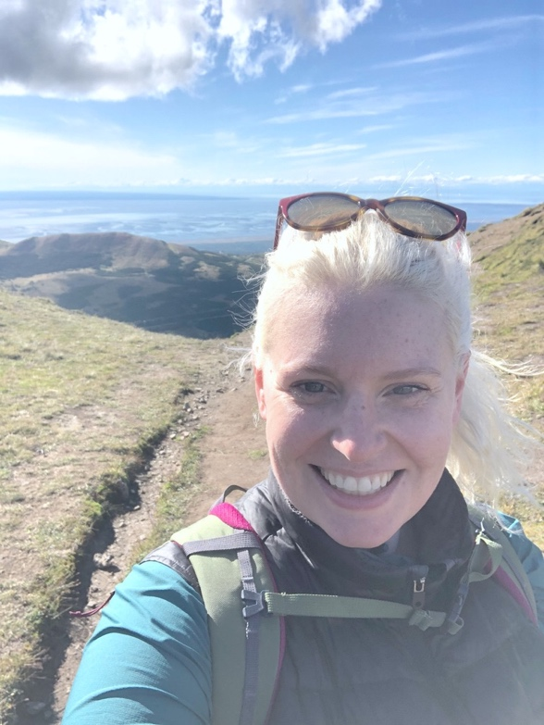
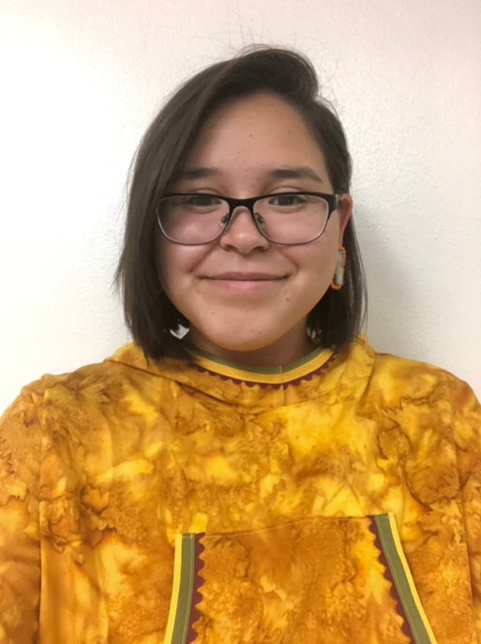
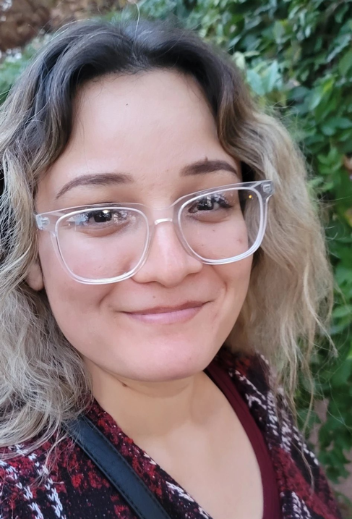
Core Research Team
ERI Project Brief | 15 December 2021
Research Team
Dr. Craig Tweedie
University of Texas El Paso
Dr. Matt Calhoun
University of Alaska Anchorage
Dr. Ben Jones
University of Alaska Fairbanks
Dr. Molly Grear
Pacific NW National Laboratories
Nagruk Harcharek
Ukpeaġvik Iñupiat Corporation
Kelsey Frazier
ADAC
Caitlynn Hanna
ADAC Undergraduate Fellow (UAF)
Brenda Almanza
ADAC Undergraduate Fellow (UTEP)

Slide 3
Project Advisors & Stakeholders
ADAC Program Year 8 Annual Meeting 19-20 April 2022
Project Advisors
Tom Douglas, Cold Regions Research and Engineering Laboratory, Ft Wainwright AK
Givey Kochanowski, Alaska Senior Advisor for the U.S. Department of Energy (DOE) Office of Indian Energy, Anchorage, AK
Project Evaluator
Dr. Nancy Kinner, University of New Hampshire, Durham, NH
Project Champion
MSTC Hugo Gaytan, Office of Port and Facility Compliance CG-FAC, Headquarters U.S. Coast Guard, Washington, D.C
MSTC Douglas Furman, Office of Port and Facility Compliance CG-FAC, Headquarters U.S. Coast Guard, Washington, D.C.
Project Stakeholders
Mr. Dan Lawrence, CG-OES, HQ USCG Washington D.C.
CDR Wes James, Office of Marine Environmental Response CG-MER, HQ USCG Washington D.C.
Mr. Shannon Jenkins, Senior Arctic Policy Advisor, CG 5PW, HQ USCG Washington D.C.
Dr. Phil McGillivary, Science Advisor USCG Pac Area, Alameda CA
Mr. Phil Thorne, Arctic Planner, USCG District 17, Juneau, AK
Mr. Mark Everett, USCG District 17, Juneau, AK
LCDR Jereme Altendorf, USCG District 17 Sector Anchorage, AK

Slide 4
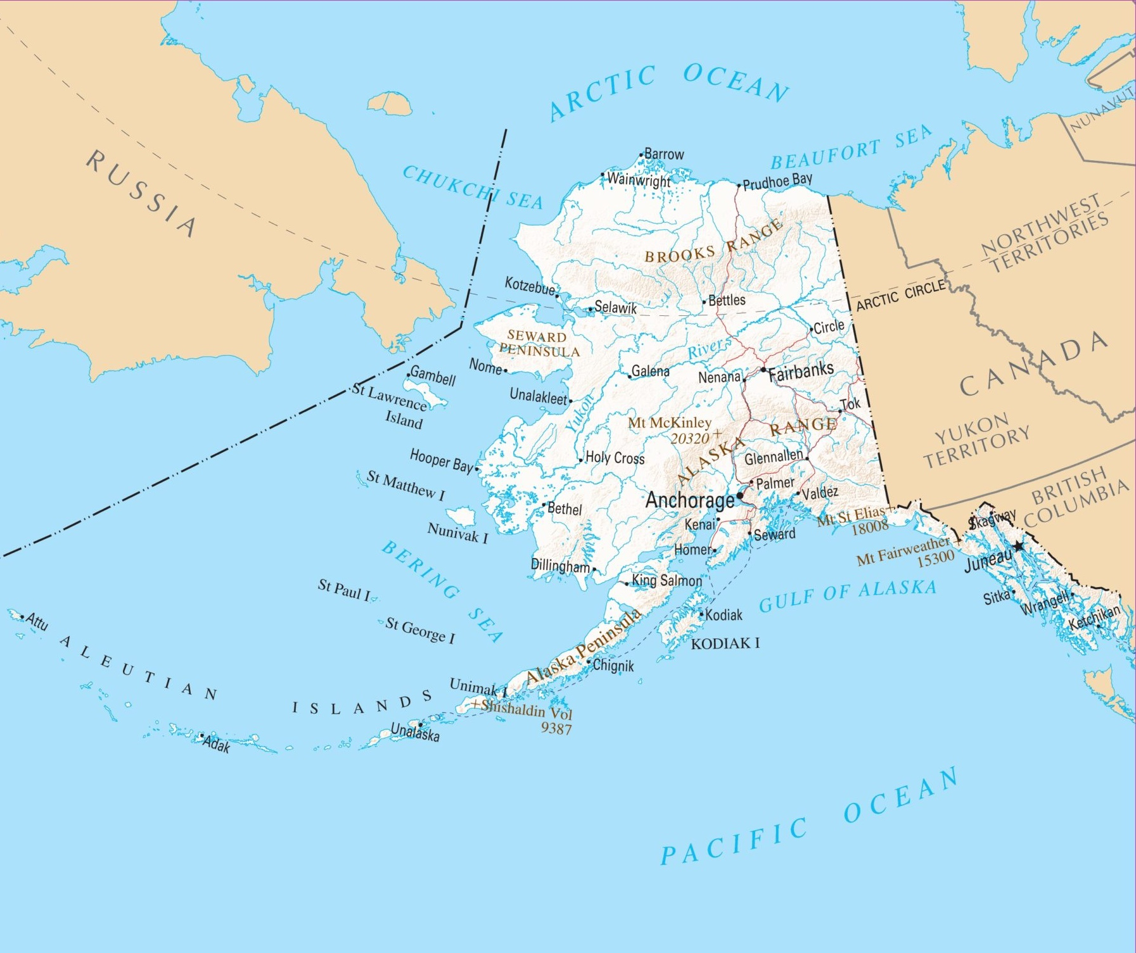

Baseline – Geographic Challenges
ADAC Program Year 8 Annual Meeting 19-20 April 2022
Anchorage → Nome: 540 miles
Anchorage → Kotzebue: 547 miles
(~distance between Washington DC and Atlanta)
Anchorage → Unalaska: 1,172 miles
(~distance between Washington DC and Miami)
USCG regulated facility inspectors are challenged with completing necessary critical inspections of potentially hazardous coastal facilities (such as fuel storage tanks) on an annual basis.
  USCG Sector Anchorage has jurisdiction that covers 5.3 million square miles, and an excess of 35,000 miles of shoreline

Slide 5
Project Focus
ADAC Program Year 8 Annual Meeting 19-20 April 2022
Alaskan USCG-regulated (under 33CFR154) bulk oil facilities and associated infrastructure that persist on permafrost coastal/riverine landscapes that are susceptible to environmental change, namely:
  bulk oil/fuel facilities and/or piers,
  platforms,
  pipelines and
  loading docks near coastal regions or nearby/adjacent waterways.
Facilities/infrastructure may be horizontal or vertically constructed.
Fuel storage facility in Shaktoolik, Alaska, a USCG regulated facility.
Notes:
-Get number of these from proposal
-all loading docks or those just for fuel
-airports?
-is port of nome a facility – check pic
-add caption for 3 main facilities

Slide 6
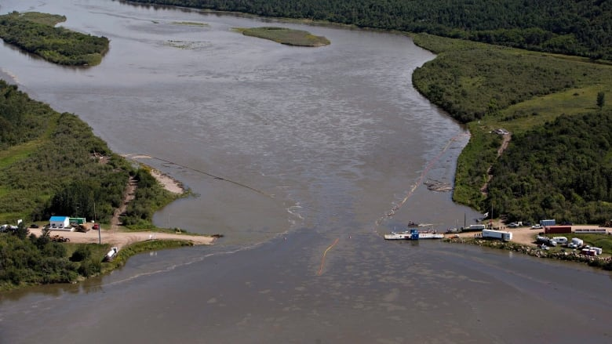
Project Outcomes
ADAC Program Year 8 Annual Meeting 19-20 April 2022
This project will create and publish three knowledge products
Synthesis of published literature, existing data, USCG reporting, and expert opinion.
Develop an “Arctic facilities and infrastructure environmental change” risk index as a USCG decision support tool.
Transition products that can be promulgated to the USCG, stakeholders, and the broader scientific and engineering community.
July 2016: Saskatchewan oil spill
Notes:
-add pics
-align text etc

Slide 7
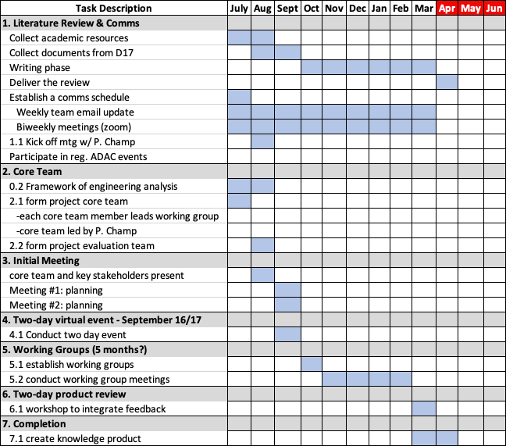
Milestones & Objectives
ADAC Program Year 8 Annual Meeting 19-20 April 2022
Task 0: Initiate investigative team
Task 1: Conduct comprehensive literature review and establish comms schedule
Task 2: Formation of project core advisory team
Task 3: Initial meetings of core team and stakeholders
Task 4: Conduct two day virtual conference
Task 5: Establish virtual working groups
Task 6: Conduct two-day workshop to review working group drafts and integrate feedback into knowledge product
Task 7: Completion of Arctic facilities and infrastructure environmental change risk index product.
Task 8: Transition products to USCG community

Slide 8
Challenges & Unforeseen Risk
ADAC Program Year 8 Annual Meeting 19-20 April 2022
Project start date scheduled for 15 Mar 2021
Kick-off meeting held 30 Apr 2021
Post meeting notice of CAPO review
After second CAPO and IRB approval, start date of 1 Jul 2021
Caused cascading effect related to researcher schedules
Effective working period of Sep 2021 – Feb 2021
Key Outcomes and Takeaways
If CAPO will be employed in future, beneficial to advise teams to add 2-4 additional months to start up timing
Organic project ideation is a unique path for DHS/USCG and show much promise. Recommend investment in ”lessons learned.”

Slide 9
Accomplishments
ADAC Program Year 8 Annual Meeting 19-20 April 2022
Task 0: Initiate investigative team. Completed
Hosted kick-off in Apr 2021
Significant project delays due to CAPO review
Task 1: Conduct comprehensive literature review and establish comms schedule. Completed.
Project team just concluded research phase on 31 Mar 2022
Knowledge product completed (draft) and under review
Task 2: Formation of project core advisory team. Completed.
Delays meant this milestone was streamlined. Core team and investigative team are the same.
Task 3: Initial meetings of core team and stakeholders. Completed.
Core team met once week during research phase; every two weeks with Project Champion
Task 4: Conduct two-day virtual conference. Completed.
Virtual event held 29/30 Sept 2021
Conference honed focus of project. Produced new data sources.

Slide 10
Accomplishments
ADAC Program Year 8 Annual Meeting 19-20 April 2022
Task 5: Establish virtual working groups. Completed.
Environmental group: constructed ArcGIS maps of all 394 bulk fuel facilities under USCG regulation. Measured elements like distance bx facility and shoreline.
Engineering group: obtained training data pointing at most significant issues. Determined significant lack of historic data.
Cast Study group: analyzed past spill reports and accidents to determine root cause.
Socio-Environment group: analyzed impacts of spills.
Recommendations from each group included in Knowledge Product.

Slide 11
ADAC Program Year 8 Annual Meeting 19-20 April 2022
Task 5: Establish virtual working groups
Environmental Change/Susceptibility
Ex: Coastal erosion rates
Ex: Permafrost Type/Thaw rates
Engineering Vulnerability
Ex: Training/Human Factor
Risk Value
Red/Yellow/Green
Weighted based on index rate
Distance to structure
Rebalancing/structural damage
More/less training; documentation, etc.
Ex: Age of Infrastructure
signs and symptoms
Known vs unknown rates
Impact/Mitigation
Ex: Impact to local wildlife, flora, humans
Ex: Mitigation ease vs. complications

Slide 12
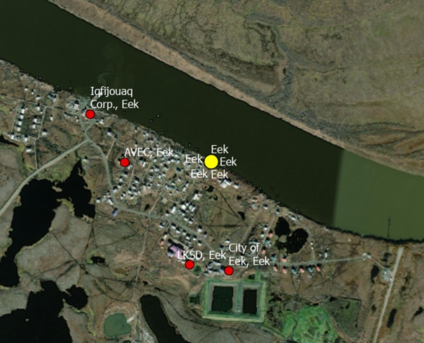
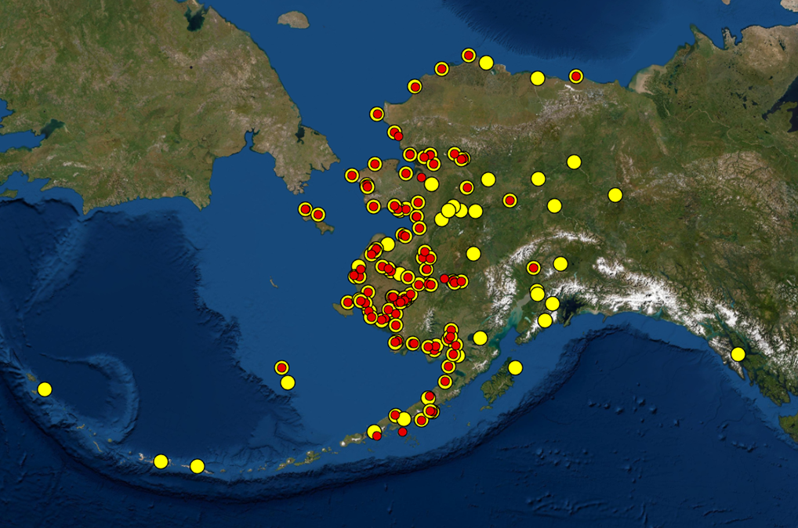
ADAC Program Year 8 Annual Meeting 19-20 April 2022
Task 5: Establish virtual working groups

Slide 13
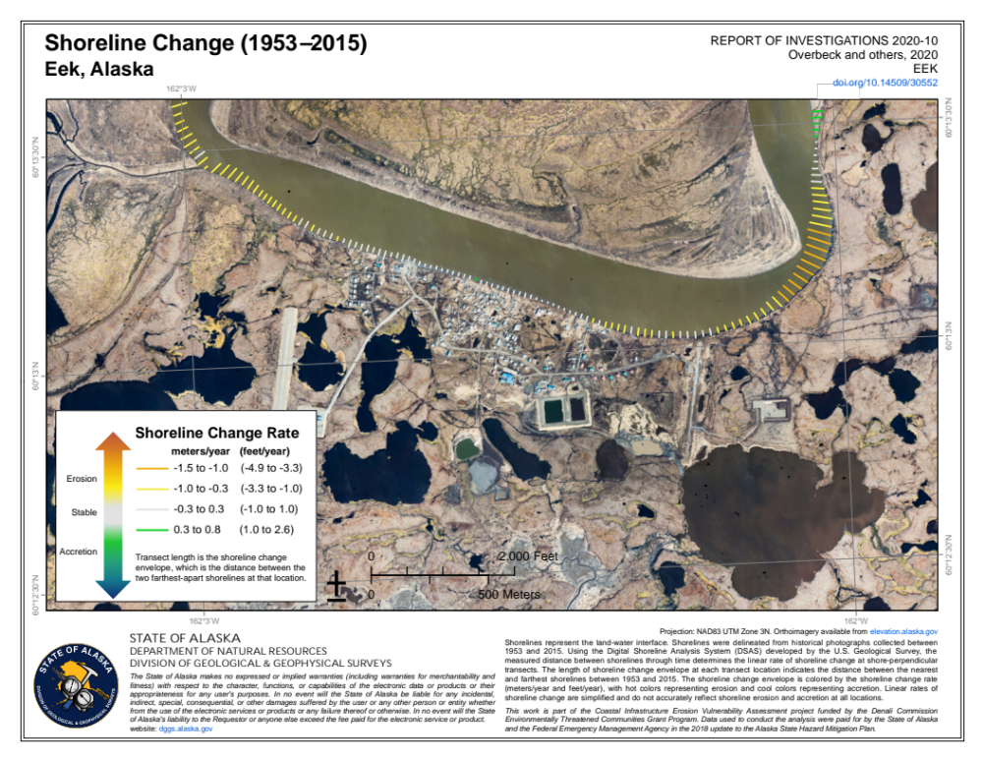
ADAC Program Year 8 Annual Meeting 19-20 April 2022
Task 5: Establish virtual working groups
https://dggs.alaska.gov/hazards/coastal/shoreline-change.html

Slide 14
Accomplishments
ADAC Program Year 8 Annual Meeting 19-20 April 2022
Task 6: Conduct two-day workshop to review working group drafts and integrate feedback into knowledge product
Consolidated. Lack of time reduced ability to meet Task 6. Coordinating feedback with Project Champion and Project Stakeholders independently. Completion scheduled for May 2021.
Task 7: Completion of Arctic facilities and infrastructure environmental change risk index product.
Forthcoming; Draft product underway. Completion scheduled for Apr/May 2021
Task 8: Transition products to USCG community
Forthcoming; handoff scheduled for June 2021

Slide 15
Recommendations & Discoveries
ADAC Program Year 8 Annual Meeting 19-20 April 2022
Recommendations
Data to transition product from tabletop/theoretical exercise
Integrate forthcoming data from DC/AEA
Provide USCG annual improvements and iterative process
Use risk evaluations to further drive scientific endeavors
Encourage organic project development but with additional support structures
Discoveries
Need a realistic method for integrating data across agencies
Class 2 facilities in Alaska have disparate data sets and no single body maintains this data
Funding – current and future needs
Incentivize bulk fuel personnel who play critical role in prevention

Slide 16
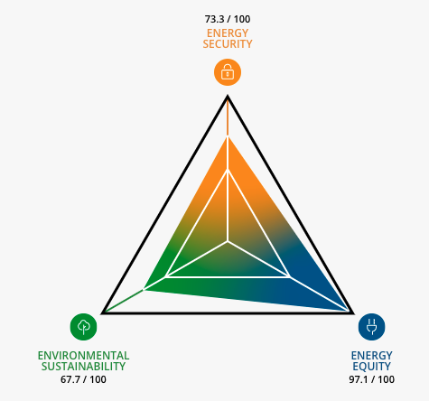
Final Thoughts & Questions
ADAC Program Year 8 Annual Meeting 19-20 April 2022
~80% of Arctic communities depend on diesel as primary energy source
Coastal communities receive single annual deliveries of fuel by barge in the summer.
Cost per person is locked in based on delivery price.
Emergency deliveries come by air lift
Depending on location, no alternative fuel sources exist
What happens if there’s a spill?
Depends on the season and distance from a “hub” city
Is the spill a result of mechanical failure? Or environmental changes?
The intention of the research team is to enhance energy security and prevent environmental impacts a spill could cause.
Source: World Energy Council, Trilemma Index

